Slide 1
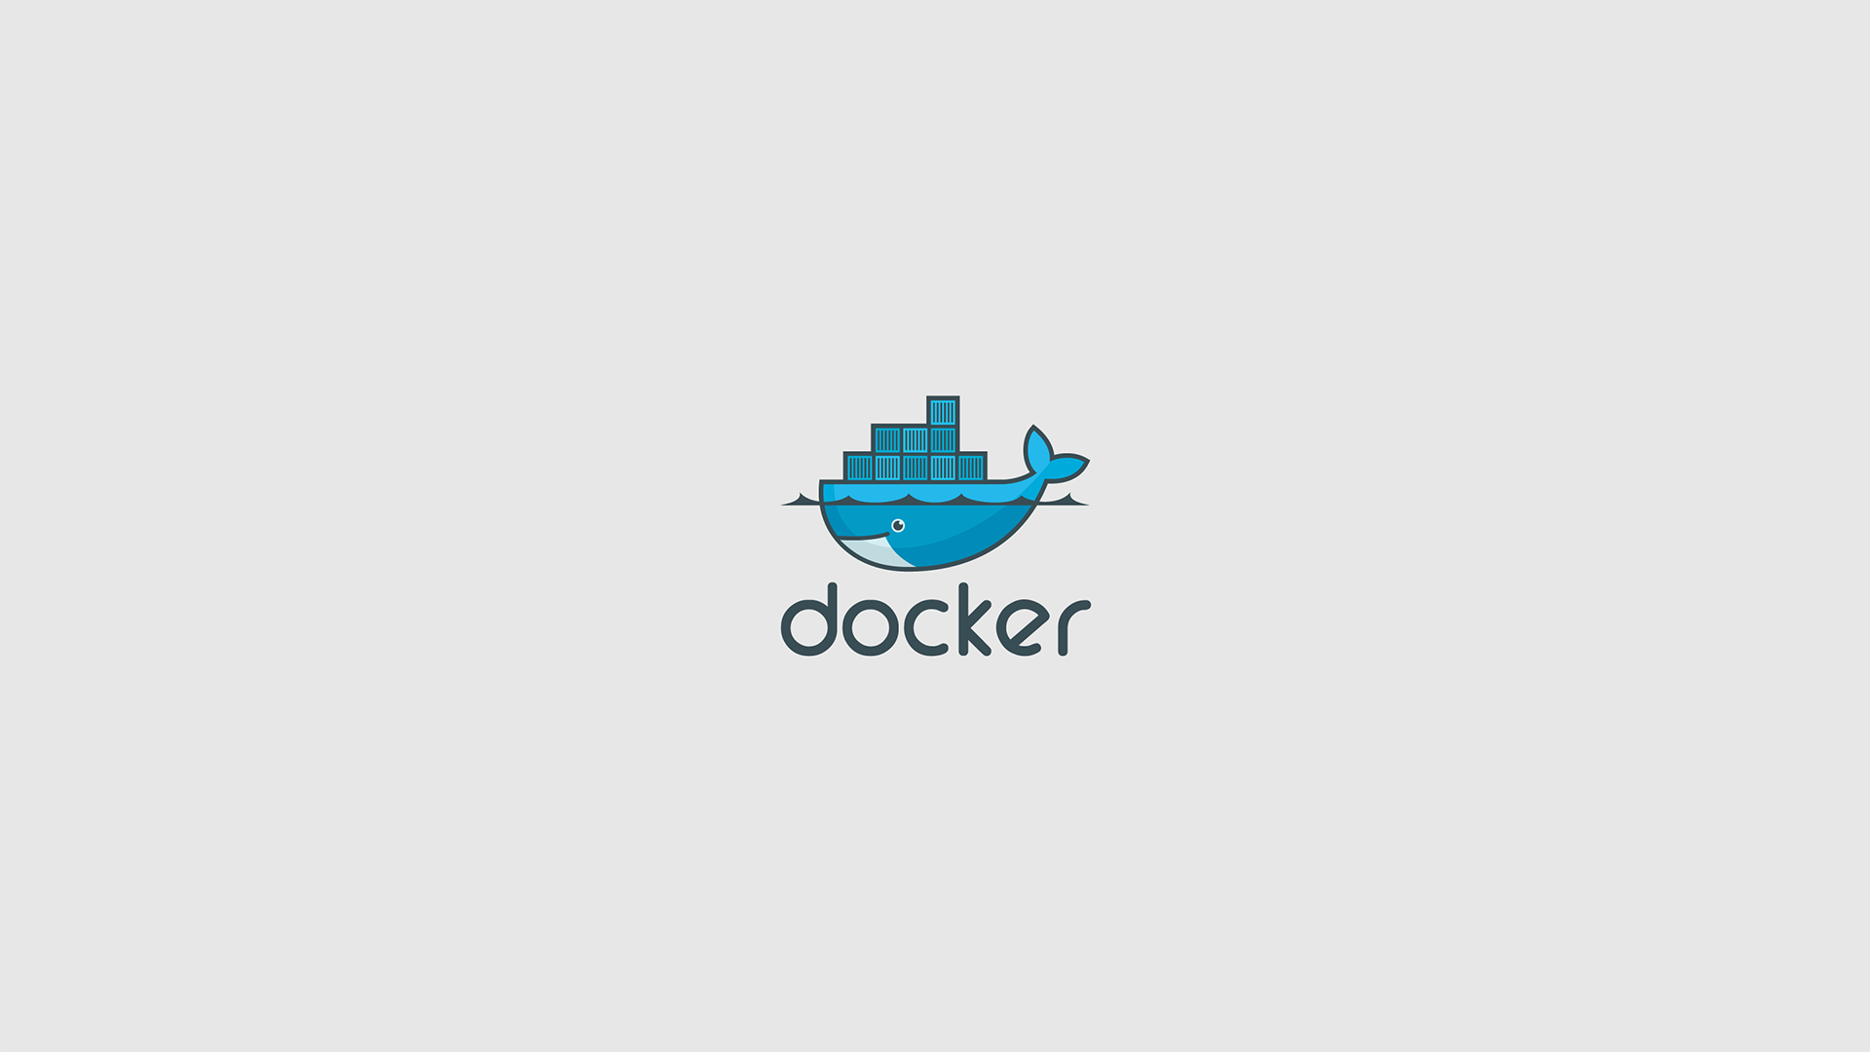
An Introduction To Docker
(Dock-umentation)
Ali Nobari
Software Developer

Slide 2
What we will cover
Images & Containers
Layers
Dockerfile
Building/Execution
Tag/Push/Pull
Services
Customize Images
Docker YAML File
Run a load-balanced App
Further Hierarchy
Swarms
Stacks
Security
Examples
Various dependencies
Custom commands

Slide 3
Let’s first understand the basics
The image is the application that you want to execute. It includes everything: the code, a runtime, libraries, and config files
A container is an executed instance of the image: what the image becomes in memory when executed, much like a process

Slide 4
Let’s look at it this way
The image: A CD
The container: A CD Player

Slide 5
A container is a lightweight VM?
Is that all the hype?

Slide 6
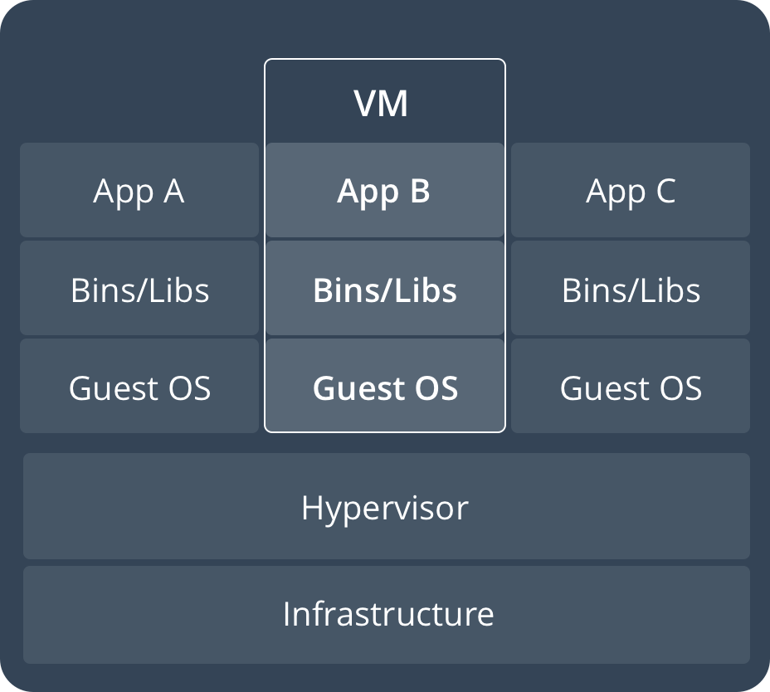
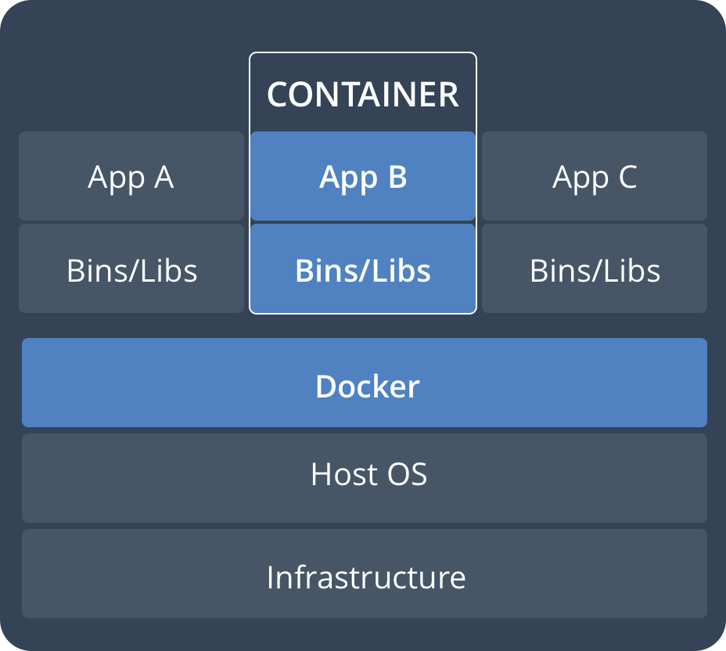
Layers! A game changing concept!
- Runs a memory-intensive guest OS
- Gives virtual access to host
- Has more resources than needed
- A container runs nativley
- Sharing the Kernel
- Only taking memory it needs

Slide 7
What can Docker do?
Fast and consist delivery of applications
  Write code/ create projects locally
  Share your work with others using Docker
  Use Docker to push to a test environment
  Seamless integration between test and development environment
Portable and easy to scale
  Can run on a mixture of environments, such as personal laptop, physical/virtual machines, or cloud provider options
Run more on the same hardware
  Docker is lightweight, and fast
  Requires less of a computers hardware

Slide 8
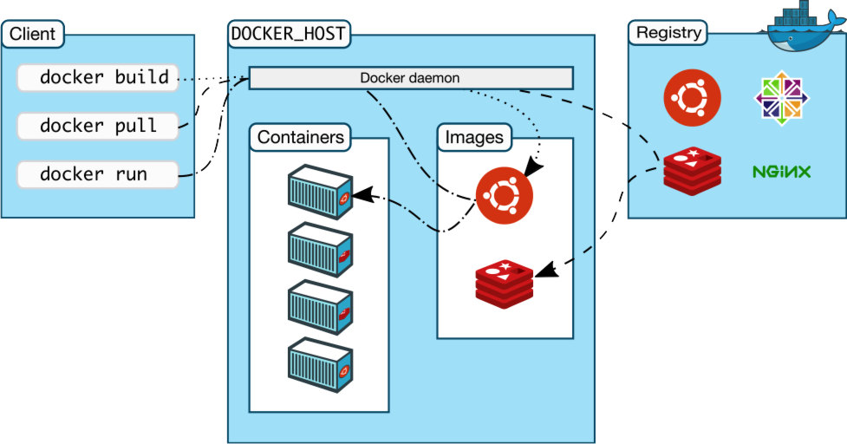
Docker Architecture Overview

Slide 9
Docker Architecture Overview
The client talks to the daemon
  They communicate either through REST API (further explanation can be given), UNIX sockets, or a network interface
The client and the daemon can run on the same system
  The daemon can be on a remote system
The daemon uses the Registry for the storing of Images

Slide 10
The Docker Client
The main way Docker users will interact with Docker
  Using the docker command over the terminal
An example is using the command docker run sending it onto dockerd(the daemon), which carries it out
The docker command uses the Docker API for communication with the Daemon
The Docker client is able to communicate with more one daemon

Slide 11
The Docker Daemon
The Docker daemon (dockerd) listens for Docker API requests
The daemon manages Docker objects including:
  Images, containers, networks, and volumes
The daemon can also communicate with other daemons to manage Docker services

Slide 12
Docker Registries

Slide 13
Install Docker

Slide 14
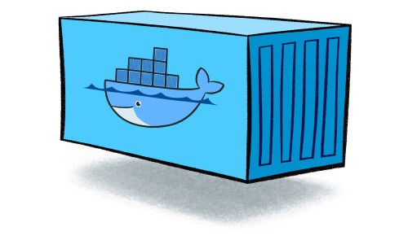
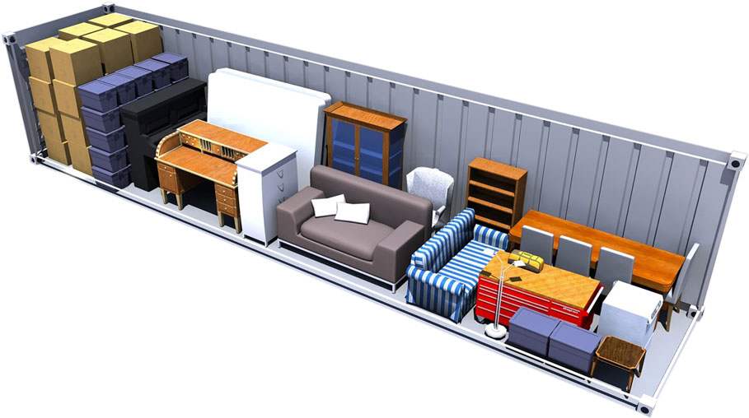
Containers

Slide 15
Containers
Defined by using a Dockerfile
  Series of instructions for building an image
  Defines the access to resources outside the container
  Specifies exactly needs to be copied in to build the image
  Dockerfile will behave exatly the same wherever it runs

Slide 16
The Dockerfile
$ mkdir docker-example
$ cd docker-example
$ nano Dockerfile
FROM ubuntu:latest
RUN apt update -y && apt install -y
  python-pip python-dev build-essential
WORKDIR /app
ADD . /app
RUN pip install -r requirements.txt
Expose 80
ENTRYPOINT [“python”]
CMD [“application.py”]

Slide 17
The Dockerfile
We first have to pick our base
From the Ubuntu image:
Ubuntu tag Compressed Size
/latest 43 MB
From the Python image:
Python tag Compressed Size
/2.7-alpine3.6 30 MB

Slide 18
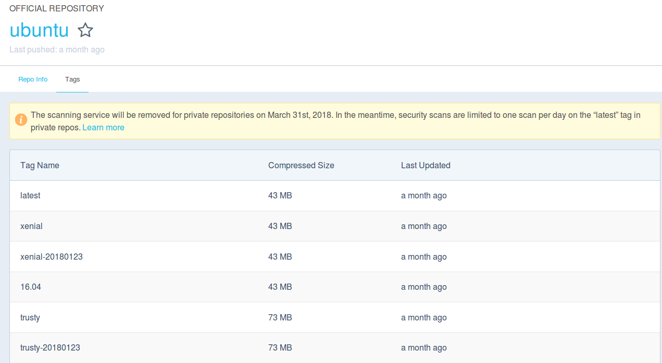
DockerHub

Slide 19
An alternative from the Ubuntu image
FROM ubuntu:latest
RUN apt update -y && apt install -y
  python-pip python-dev build-essential
WORKDIR /app
ADD . /app
RUN pip install -r requirements.txt
Expose 80
ENTRYPOINT [“python”]
CMD [“application.py”]

Slide 20
An alternative from the Ubuntu image
FROM python:2.7-alpine3.6
WORKDIR /app
ADD . /app
RUN pip install -r requirements.txt
Expose 80
ENTRYPOINT [“python”]
CMD [“application.py”]

Slide 21
Using a custom base container
FROM python:2501231234/docker_app1
WORKDIR /app
ADD . /app
RUN pip install -r requirements.txt
Expose 80
ENTRYPOINT [“python”]
CMD [“application.py”]

Slide 22
Setting a working directory
FROM ubuntu:latest
RUN apt update -y && apt install -y
  python-pip python-dev build-essential
WORKDIR /app
ADD . /app
RUN pip install -r requirements.txt
Expose 80
ENTRYPOINT [“python”]
CMD [“application.py”]

Slide 23
Copy the current directory to the container
FROM ubuntu:latest
RUN apt update -y && apt install -y
  python-pip python-dev build-essential
WORKDIR /app
ADD . /app
RUN pip install -r requirements.txt
Expose 80
ENTRYPOINT [“python”]
CMD [“application.py”]

Slide 24
Defining the RUN statements
FROM ubuntu:latest
RUN apt update -y && apt install -y
  python-pip python-dev build-essential
WORKDIR /app
ADD . /app
RUN pip install -r requirements.txt
Expose 80
ENTRYPOINT [“python”]
CMD [“application.py”]

Slide 25
A more correct approach to RUN and ADD
Bad space usage:
ADD http://site.come/largefile.tar.xz /app/site
RUN tar -xvf /app/site/largefile.tar.xz -C /app/site
RUN make -C /app/site/ all
Wise space usage:
RUN mkdir -p /app/site/ \
  && curl -SL http://site.come/largefile.tar.xz /app/site \
  | tar -xvf /app/site/ &&
  /app/site/largefile.tar.xz -C /app/site \
  && make -C /app/site/ all

Slide 26
Requirements File
Requirements file defines additional dependancies needed by docker
It installs the needed dependancies for the application
Used to simplify and organize the Dockerfile

Slide 27
Entrypoint/CMD
FROM ubuntu:latest
RUN apt update -y && apt install -y
  python-pip python-dev build-essential
WORKDIR /app
ADD . /app
RUN pip install -r requirements.txt
Expose 80
ENTRYPOINT [“python”]
CMD [“application.py”]

Slide 28
